Slide 1
World Accreditation Day 2017
Technical Seminar on Accreditation
Delivering Confidence in Construction and the Built Environment
Implementation of National Construction Policy
Issues and Challenges

Slide 2
VALUE ADDITION BY THE CONSTRUCTION SECTOR TO GDP
Construction industry is a major contributor to the national economy and major driver of the employment creation
Source – Department of Census & Statistics

Slide 3
Employment by Selected Industrial Groups
Construction sector generates employment for over six hundred thousand people

Slide 4
Construction Sector has become a major value additor to the National Economy contributing a 1/10 of the GDP
PERCENTAGE SHARE OF GROSS DOMESTIC PRODUCT
Percentage share
Source – Department of Census & Statistics

Slide 5
GROWTH RATE OF CONSTRUCTION INDUSTRY AT CONSTANT PRICES
Construction Sector has recorded an impressive growth rate continuously after the year 2010 due to the eradication of three decade long conflict.
Source – Department of Census & Statistics

Slide 6
Construction Industry Act No. 33 of 2014 was enacted in the year 2014 to Regulate, Register, Formalise and Standardize the Construction Industry
Act also provide for the establishment of National Advisory Council on Construction, Establishment of the Construction Industry Development Authority and the Construction Industry Development Fund

Slide 7
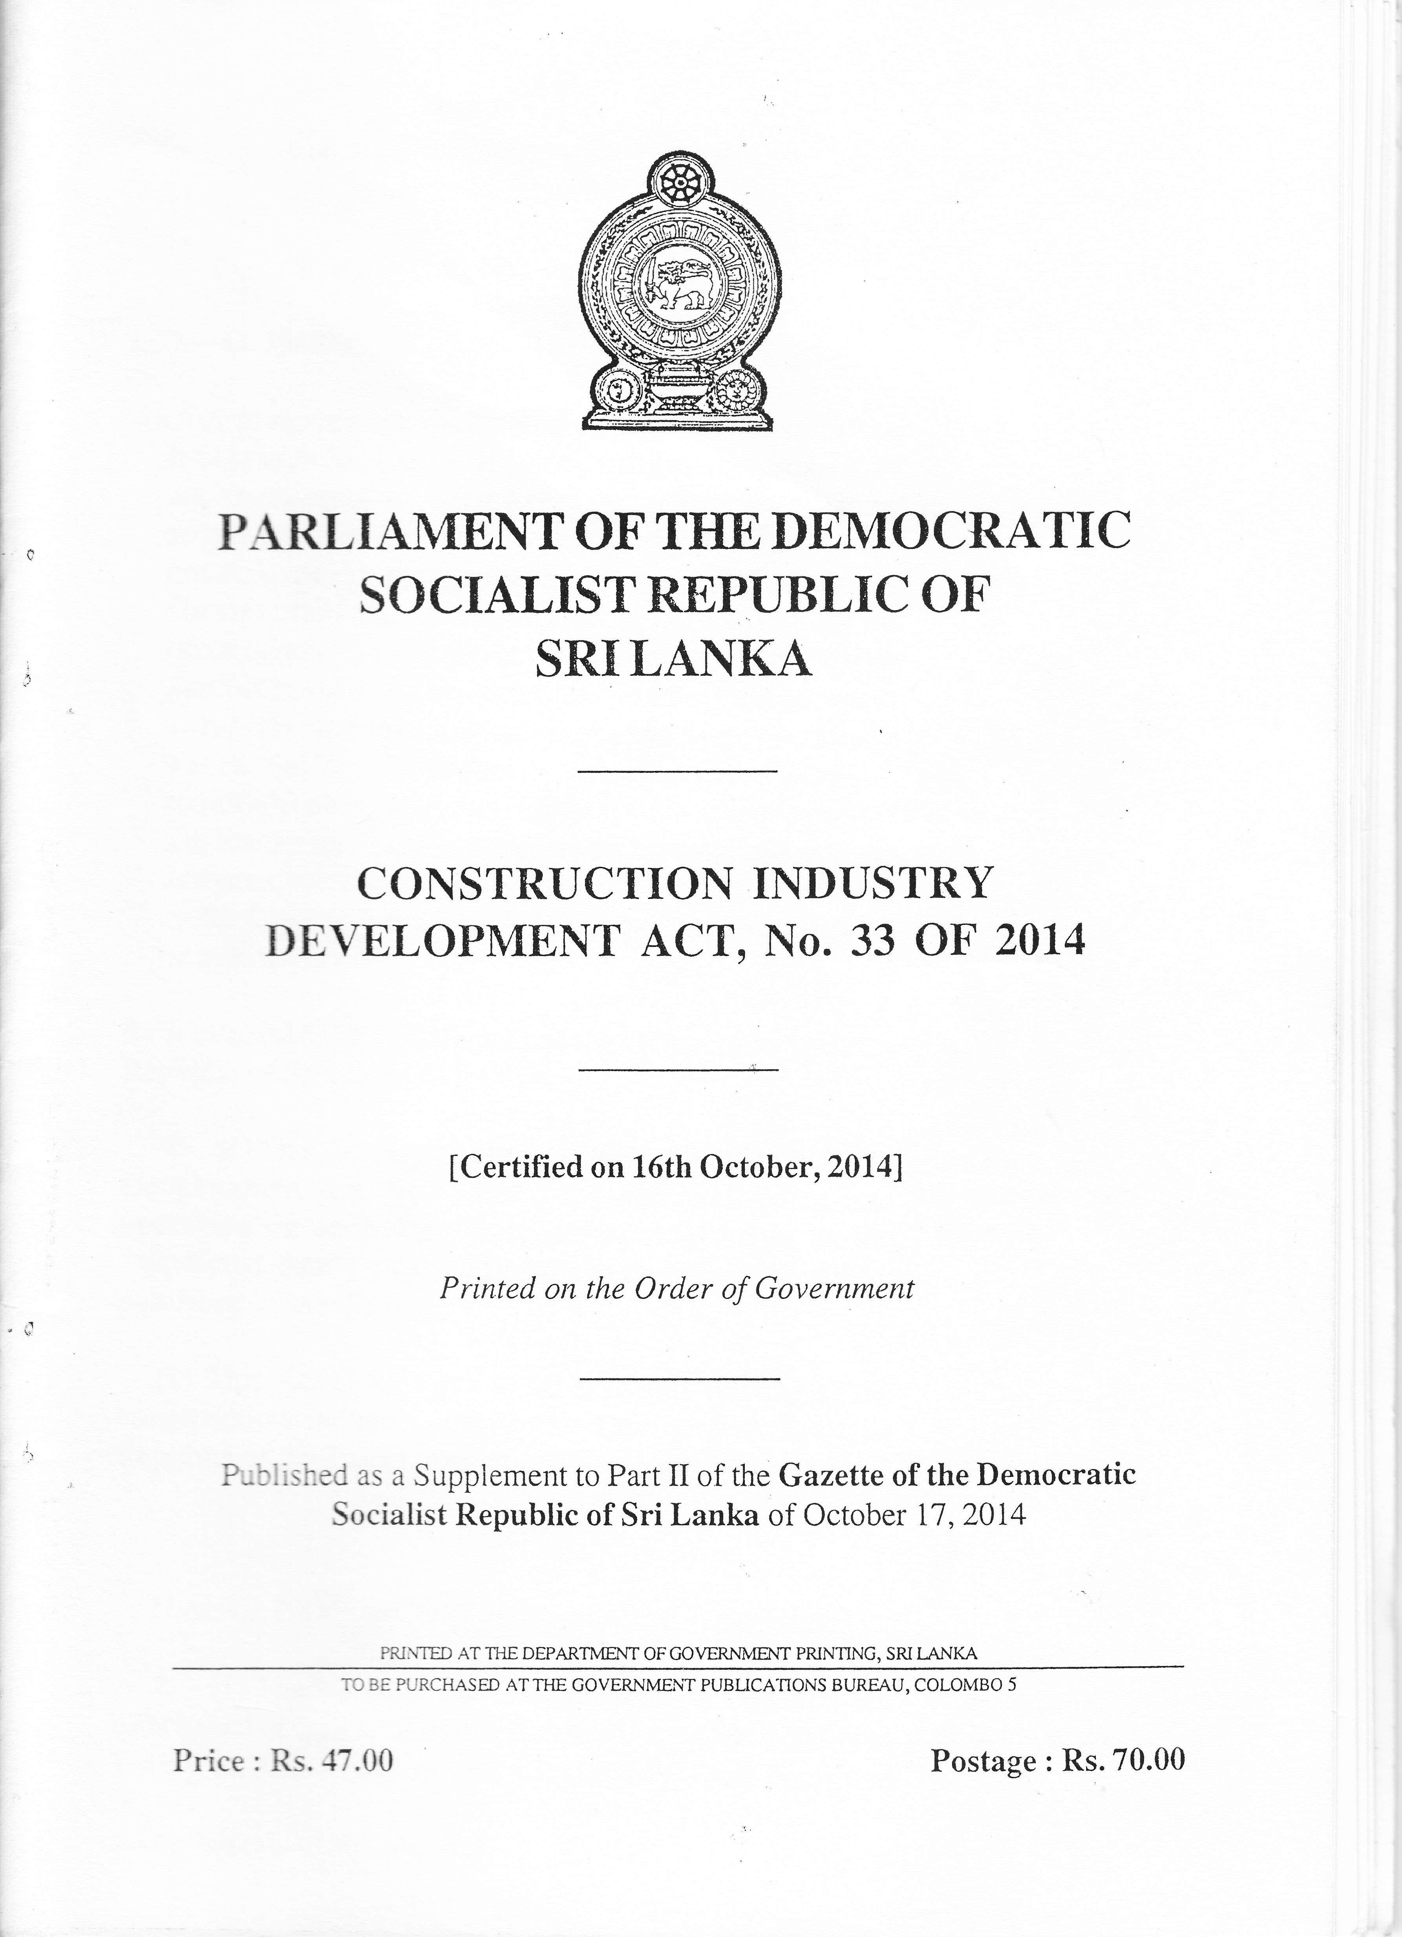
Efforts made according to the conditions surrounding the construction Industry
Establishment of the legal frame work ,policy frame work and institutional frame work are the major reforms introduced for the achievement of a sustainable construction industry
Establishment of legal framework through the Enactment of Construction Industry Development
Act No. 33 of 2014
The Construction Industry Development Act. No. 33 of 2014 was enacted by the Sri Lanka Government making provisions for development of the Construction Industry in Sri Lanka publishing rules and regulations creating a environment where all stakeholders can play their respective roles in co-ordinated, integrated and inclusive manner ensuring its sustainable growth.

Slide 8
Establishment of the National Advisory Council on Construction
Powerful body comprising of all the Ministries involved in construction and Professional bodies representing the construction industry
The objectives for which the Advisory Council is setup are mentioned below :
Formulate and amend the national policy on construction and its implementation mechanism
Make representations to the Minister on any need for the development of the construction industry
Advise the Minister and make recommendations on any regulation to be made under this Act
Advise and make recommendations to the Authority on strategic issues, policies and legislative proposals that may affect or which is incidental or connected with the construction industry

Slide 9
NATIONAL POLICY ON CONSTRUCTION
Presenting National Policy on Construction to His Excellency the President giving holistic vision and strategic direction to the Sri Lankan Construction industry to the

Slide 10
Policy Elements
Vision Statement
A policy vision of achieving an efficient construction industry in Sri Lanka serving the national economic development needs through regulation, standardisation to the levels that are in par with the global standard has been adopted.
Policy Objectives
Policy Objectives includes providing strategic leadership to alL stakeholders of the Construction Industry, stimulate sustainable growth, reforms and improvements, promote energy efficient and environmental friendly technology, building materials and systems, promote appropriate research and dissemination and publication of research work, formulate standards and codes of conduct and practices and promotion of export of construction services.

Slide 11
National Policy on Construction
National Policy on Construction has been formulated setting eighteen policy elements to be implemented by the public and private sector ensuring the productive and efficient participation of all the stakeholders of the Construction Industry.
Policy will provide the strategic direction and integrated and cohesive approach ensuring the increased participation of all stake holders ensuring inclusive growth of the Construction Industry.
Policy consists of eighteen policy elements which cover the entire spectrum of the construction industry.

Slide 12
THE NATIONAL POLICY ON CONSTRCTION (NPC)
1. Public Sector Responsibilities and Implementation Mechanism
NPC 1 - Provide strategic leadership to the stakeholders of the construction industry to stimulate sustainable growth, reforms and improvement of the construction sector
Implementation Mechanism:
The National Advisory Council on Construction and the Construction Industry Development Authority will engage with key Cabinet Ministries and other Public and the Private Sector organizations involved with construction, infrastructure delivery and financing, to ensure a coordinated approach at policy level

Slide 13
NPC 2 - Regulate and monitor the activities of all stakeholders of the construction industry as may be prescribed from time to time
Implementation Mechanism:
The Construction Industry Development Authority in consultation with the relevant public sector agencies and professional bodies will:-
review and update guidelines and implement a registration and a monitoring system for all stakeholders.
ensure the uniform application of the standard bidding documents and such other guidelines and publications among the public and private sectors
ensure effective and expeditious resolution of construction related disputes, by establishing and promoting the alternate dispute resolution methods and necessary legislation.

Slide 15
Encourage external accreditation of Management Systems
Mandatory requirement of possession of system Management
For Grade CS2 = ISO 9000 ISO 14000 , OHSAS 18000
For Grade CS1 = ISO 9000 ISO 14000 , OHSAS 18000
For Grade C1, C2, C3 = ISO 9000
ISO 9000 - Quality Management Systems
ISO 14000 - Environmental Management systems
OHSAS - Occupational safety and health
Certification by the Institution accredited by the recognised accreditation body is a proof that management systems practised by the local contractors are on par with the international standards so that local contractors can be competitive in the global market competing with their international counter parts

Slide 16
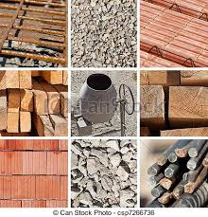
4. Registration of Construction Materials & Component Suppliers
Documents Prepared (Materials & Component Suppliers)
Complete set of documents require for commencing Material Suppliers registration has been compiled, as per Act part VI, 43)
Registration of Construction Material and Suppliers programme will commence soon ensuring the quality of materials at market as the market is flooded with low quality materials
Initially registration will be done for identified set of materials.

Slide 17
NPC 3 - Promote sustainable economical growth of the construction industry with special attention to the design and development of disaster resilient, energy efficient and environmentally sustainable buildings, structures and construction practices
Implementation Mechanism
Ministries responsible for the subjects of Construction, Disaster Management, Power and Energy and Environment will collaborate to establish norms and guidelines in consultation with the relevant professional bodies, research organizations and the universities to formulate disaster resilient, energy efficient and environmentally sustainable construction practices
Not less than 5% of the fund shall be reserved for the purpose of rewarding and encouraging the inventions, applications and propagation of environmentally friendly and cost effective construction technologies

Slide 18
Quite slow nature of introduction of innovative materials and construction methods
The supply of energy to the increasing demand is becoming more and more serious
The building sector consumes 40% of energy emitting 30% of green house gases
It is increasingly required to introduce environmentally friendly technologies encouraging the use of renewable energy sources leading to the substantial reduction in energy usage and demand
Sharing of knowledge and transferring of technologies in the field of energy conservation and use of renewable energy is very appropriate at this juncture
Slow growth in technology transfers in FDIs and other Donor Funded projects has reduced equitable sharing of global technological advances and their applications in raising the standards of the industry.

Slide 19
NPC 4 - Promote innovation, research, dissemination and publication of research work on matters relating to the construction industry and its development.
Implementation Mechanism:
Construction Industry Development Authority will encourage research and development in materials, building and construction technology through collaboration among large industry players, the universities and other institutions, international organizations, government entities and NGOs and in the area of “Geotechnical Investigations and Designs” specifically through National Building Research Organization.
Or research and publications
Not less than 5% of the fund shall be reserved for research and publications in the field related to the construction industry

Slide 20
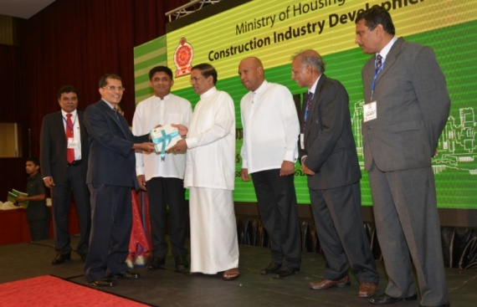
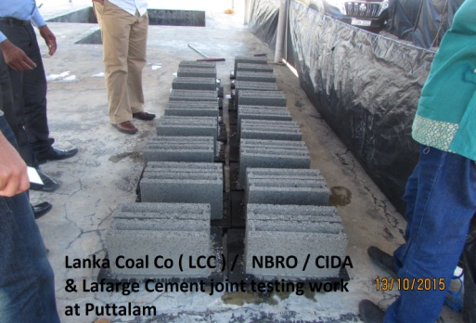
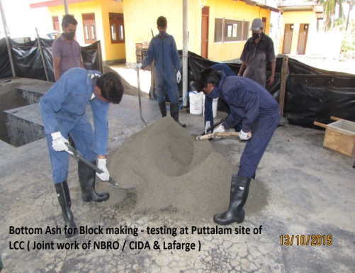
Technology & Research Promotion
As Per CID Act part III, 13 (30)
Sri Lankan Construction Industry, for many years has been relying on traditional technologies comprised of conservative construction methods and materials. However, it is required to develop and innovate new technologies to obtain higher productivity, while mitigating negative environmental impacts and reducing high construction costs.
Development of policy recommendation document on Alternative for River Sand;
Task force established by the Ministry to ensure the speedy implementation of the recommendations .
Report of the Task force is being prepared.
Promoting of Research
Research Council was established, with members of NSF, NBRO, NERDC, NCASL, CCI, IDB, SLIA, IESL, IQSL, UOM, UOP, UOR, UOJ, COSTI.
Two Brain Storming sessions were conducted & research requirements of Construction Industry were identified.
A decision taken to collect available research papers already published for converting into commercial viable products /processes.

Slide 21
NPC 5 - Establish national standards and specifications for the construction Industry
Implementation Mechanism:
Construction Industry Development Authority will formulate, in consultation with Sri Lanka Standards Institution, National Building Research Organization, and other relevant authorities, standards and national quality specifications applicable to Construction Industry, including standards for Product Conformity of Construction Materials and categorize such standards and specifications as compulsory or voluntary.
Specifications = CIDA has published the specification for the building works CIDA publication no. SCA /4/1

Slide 22
Material standards = Sri Lanka Standard Institution
Cement
Cement shall be from an approved source and shall be one of the following types of cement as specified.
Type In accordance with
Ordinary Portland Cement SLS 107
Rapid Hardening Portland Cement
White Portland Cement BS EN 197 (BS 12)
Coloured Portland Cement
Portland Blast Furnace Cement BS 146
Low Heat Portland Cement BS 1370
Sulphate Resisting Portland Cement BS 4027
Low Heat Portland Blast Furnace Cement BS EN 197 (BS 4246)
Super Sulphated Cement BS 4248
Ultra High Early Strength Portland Cement The requirements for physical
Water Repellent Portland Cement properties for Ordinary Portland Cement
Hydro-phobic Portland Cement given in SLS 107 or BS EN 197 (BS 12)
Portland Lime Stone Cement SLS 1253
Blended Hydraulic Cement SLS 1247
Masonry Cement SLS 515

Slide 23
Steel Reinforcement
The reinforcement shall be :
Hot rolled mild steel round bars
for concrete reinforcement - SLS 26
2. Hot rolled high yield steel bars
for concrete reinforcement - BS 4449
Ribbed steel bars for the
reinforcement of concrete - SLS 375
Hard drawn mild steel wire for
the reinforcement of concrete - BS 4482
5. Steel fabric for reinforcement of concrete - SLS 95

Slide 24
Serial No. | HS Codes | Article Column III | Sri Lanka Standard Column IV
1 | 2523.21 2523.29.10 2523.29.20 2523.29.30 | Ordinary Portland Cement | SLS 107 Specification for Ordinary Portland Cement
2 | 3917.23 | Conduits for Electrical Installation | SLS 993 Specification for conduit systems for cable Management Part 1 General Requirements Part 2 Rigid Conduit of Systems Part 3 Pliable Conduit Systems Part 4 Flexible Conduit Systems
3 | 3917.23 | PVC-U (unplasticized poly (vinyl chloride )) pipes for water supply and buried and above ground drainage and sewerage under pressure | SLS 147 Specification for (unplasticized poly (vinyl chloride)) pipes for water supply and for buried and above ground drainage and sewerage under pressure
4 | 3917.40.90 | PVC-U (unplasticized poly (viny1 chloride)) pipe joint and fittings for potable cold water supplies | SLS 659 Specification for PVC-U (unplasticized poly (viny1 chloride)) pipe joints and fittings for potable cold water supplies
5 | 3925.10 3925.90 | Polyethylene Water Storage Tanks | SLS 1174 Specification for Polyethylene Water Storage Tanks

Slide 25
Serial No. | HS Codes | Article Column III | Sri Lanka Standard Column IV
6 | 6811.40.10 | Asbestos Cement Corrugated Sheets | SLS 9 Specification for Asbestos Cement Products Part 2 Corrugated Sheets
7 | 6811.40.20 | Asbestos Cement Flat Sheets | SLS 9 Specification for Asbestos Cement Part 1 Flat sheets
8 | 7213.91 7213.99 7214.10.90 7214.91.20 7214.91.90 7214.99 7215.90 7227.90 | Plain Steel bars and Coils for the reinforcement of concrete | SLS 26 Specification for Plain Steel bars for the reinforcement of concrete
9 | 7213.10.10 7213.10.90 7214.20.10 7214.20.90 7215.90 | Ribbed steel bars for the reinforcement of concrete | SLS 375 Specification for Ribbed steel bars for the reinforcement of concrete
10 | 7217.10 7217.20.10 7217.20.20 7217.20.90 | Mild Steel Wires | SLS 139 Specification for Mild Steel Wires for General Engineering purposes

Slide 26
Standard of the imported materials
Regulations have been gazetted as to the quality of the imported materials under the import and exports control act no 01 of 1969 as amended by act no 28 of 1987
Every importer shall in respect of each article imported by him furnish to the director General of SLSI a certificate of compliance with the Sri Lanka standards stipulated for the article issued by the laboratory in the exporting country either accredited by the recognised accreditation body or recognised by the Sri Lanka Standard Institution

Slide 27
NPC 6 - Establish codes of conduct, practices, procedures, processes and documentations to promote good practices relating to construction industry
Implementation Mechanism:
The Construction Industry Development Authority in consultation with all stakeholders and professional bodies including trade guilds will develop appropriate codes of conduct and acceptable practices. Appropriate sanctions where applicable will also be included in the process against defaults.

Slide 28
NPC 7 - Enhance human capital, professionalism, efficiency and productivity of the human resource of the construction industry
Implementation Mechanism:
Construction Ministry in collaboration with the ministries responsible for education & vocational training, and in consultation with all Professional Bodies will:
prepare programmes to cater to manpower shortages in the industry,
improve the quality of performance of professionals, technical officers and tradesmen,
promoting the use of IT in the industry
recognition and image building of industry personnel and
encourage good practices and standards through codes of conduct.
These HRD initiatives will be implemented with the objective of:
Affording opportunity for women in industry occupations
Providing opportunities for ‘Special Needs’ groups
Ensure proper remuneration for workers
Recognition and image building of industry personnel
Facilitating the development of skilled labour and the training of the industry’s unskilled workforce in a systematic manner and regulating the labour sub contracting system
Facilitating a system of recognition and certification of skilled and trained workers
Facilitating employment of a specified minimum of construction skilled workers with NVQ in the workforce of registered contractors.
Promoting accident insurance and retirement benefits to construction workers

Slide 29
Main issues with the construction industry
Shortage of skilled labour :
The scarcity of skilled craftsmen in the sector is one of the main challenges faced by local contractors. Less than five percent of construction workers in the country have been systematically trained and carry certificates that are indicative of their skill. Therefore, it is imperative that the government and the industry join hands and initiate an island-wide construction worker skill development programme via technical colleges to develop a strong structural base for the Sri Lankan Construction Industry through manpower training and development.

Slide 30
Shortage of skilled labour :
The composition of the GDP has shifted from agriculture to industry and services sector.
Agriculture share of GDP declined from 20% to 11%.
Share of the industry has increased from 27% to 33%.
School curriculum technical education and vocational training programmes have not evolved adequately to meet changing demands, resulting in a large skill gap and mismatch in the local labour force.
Lack of adequate skill is one of the major constraints in operating and growing business, third only to tax and regulation.

Slide 31
Trends in Selected Crafts & Related Worker Jobs
Considerable decline can be observed in foreign employment placement due to the employment opportunities created by the massive emerging growth in the construction sector .

Slide 32
The image of industry :
Reluctance of young generation to join the
Construction Industry
The construction industry has been classified as a 3D industry (Dirty, Difficult, Dangerous)
It is required to transform the industry image from 3D to 3P. (Professional, Productivity and Progressive industry)
Recognition and rewarding of construction craftsmen “
It was started with the goal of promoting youth from island wide to enter into the industry and encourage skills enhancement among construction workers, who are already in the trades.

Slide 33
Certified work force to increase productivity and quality of work maintaining the highest standards
CIDA will soon commence registering of all the construction craftsmen practising in the construction industry giving them a identity card indicating their level of skills and providing them with long term insurance and retirement benefits
All the construction craftsmen who do not posses a valid certificate will be encouraged to obtain a National Vocational Qualifications (NVQ) under the system of recognition of prior learning ( RPL ) before being resisted as a qualified construction craftsman
No person other than a craft identity card holder shall be engaged independently in any identified construction work unless under the supervision of a craft identity card holder on the relevant craft
Vocational Training leading to the awarding of National Vocational qualifications should be carried out by the institutions accredited by the Tertiary and vocational education commission so that quality and standard of the training can be assured

Slide 34
NPC 8 - Enhance occupational safety and health standards and practices in the Construction Industry
Implementation Mechanism:
Construction Industry Development Authority:
Will ensure health and safety standards for construction personnel
Will facilitate procedures for the preparation and implementation of acceptable site-specific safety management plans or safe work methods in all construction projects.
Will define processes through which construction work will be safe and not injurious to health by encouraging training of personnel in these areas.
Mandatory requirement of engagement of construction safety and occupational health managers / construction safety and occupational Supervisors and Officers,
Grade CS1 and CS2 – 01 Construction Safety and Occupational Health Manager, 02 construction safety and occupational health officers, 03 construction safety and occupational health supervisors

Slide 35
NPC 9 - Enhance the use of Information Technology to improve efficiency and productivity of the construction industry processes
Implementation Mechanism:
Construction Industry Development Authority will identify and promote in association with relevant agencies:
the use of appropriate IT based systems in planning and designing, estimating and cost control, documentation and communication, project management and contract administration etc. in the construction industry
the greater use of Information Technology for improving efficiency and productivity of the Construction Industry.
the establishment of an industry-wide statistical database in the exercise of this Policy, with information on resources, projects, industry players and linkages to related industries and sectors.

Slide 36
NPC 10 - Promote access to overseas markets for Construction Companies and personnel
Implementation Mechanism:
Construction Industry Development Authority through the Construction Ministry, in collaboration with the Ministries responsible for External Affairs and Commerce, Sri Lanka Export Development Board and Central Bank of Sri Lanka, shall:
establish a network to gather information on work opportunities in the targeted countries
create an enabling environment for securing such work for the local industry.
facilitate promotional efforts to secure overseas work for the local industry
Introduction of continuous competency development programme for all the contractors registered with CIDA to ensure that they will continue to develop their practices to be on far with the global standards being competitive in the international market

Slide 37
NPC 11 - Create an enabling environment for local and foreign investment in the construction Industry
Implementation Mechanism:
Construction Industry Development Authority in association with the other regulatory authorities and approving agencies will:
establish reforms that will lead to improvement and acceleration in the approval processes for investments and development projects in the construction industry
facilitate the growth and development of new enterprises and service providers with required potential
establish mechanisms to attract investment in construction and infrastructure development from private sector and foreign direct investment
Creating of one stop shop for all the planning and other clearances improving the ranking of the doing business index

Slide 38
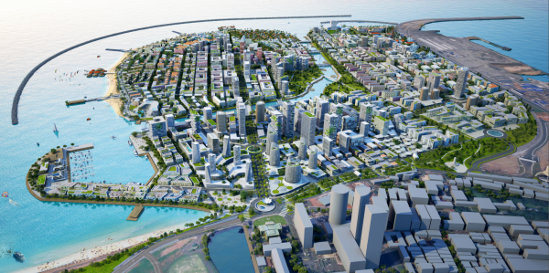
COLOMBO PORT CITY
Colombo port city – massive development drive will transform the Colombo creating more investment opportunities driving the economic growth of the metro polis
Port City Video

Slide 39
Financial city Colombo
Availability of skilled work force will be the one of the most vital factors which Investors will take into consideration when making their investment decisions

Slide 40
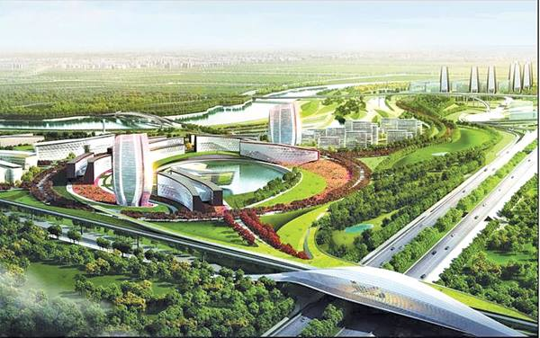
WESTERN MEGAPOLIS DEVELOPMENT
Labour shortage presently being experienced will be further aggravated unless necessary policy reforms is introduced to over come the shortage of resources

Slide 41
LABOUR PROJECTION FOR THE SRI LANKAN CONSTRUCTION INDUSTRY FOR NEXT FIVE YEARS
(Upto 2020)
Segregation of Labour
NO. | DESCRIPTION |  |  | NUMBERS
1 | Unskilled |  |  | 752,308 | 40.50%
2 | Skilled Civil Masons Painters |  |  | 460,115 | 24.77%
3 | Carpenters & Fabricators |  |  | 241,667 | 13.01%
4 | Skilled MEP Plumbers Electricians |  |  | 347,362 | 18.70%
5 | Technical supportive staff |  |  | 39,659 | 2.14%
6 | Administrative support Staff |  |  | 2,300 | 0.12%
7 | Professionals (Approx, Projection) |  |  | 14,139 | 0.76%
7.1 | Project Managers | 1,131 | 8%
7.2 | Architects | 1,414 | 10%
7.3 | Civil Engineers | 6,363 | 45%
7.4 | MEP Engineers | 3,535 | 25%
7.5 | Quantity Surveyors | 1,696 | 12%
Total Human Resource Requirement |  |  |  | 1,857,550.00 | 100%
Note: This is only a future prediction
Source : 2006 budget and megapolis development plan

Slide 42
Construction material prices and indices
Material price indices compiled by the ICTAD reflect that the material prices have increased at a moderate pace from the year 2008 to 2011. But with the launching of massive development drive by the Government in the post war environment, the material prices have gone up dramatically due to the robust increased in demand.
Material | 2008 | 2009 | 2010 | 2011 | 2012 | 2013 | 2014 | 2015
Lime | 100.00 | 103.94 | 105.36 | 106.85 | 110.35 | 121.10 | 125.20 | 126.54
Reinforcement | 100.00 | 81.90 | 83.66 | 91.68 | 98.89 | 99.33 | 99.33 | 99.33
Asbestos Roofing Sheet | 100.00 | 102.46 | 107.47 | 119.68 | 141.31 | 148.25 | 154.15 | 154.15
PVC | 100.00 | 104.05 | 106.36 | 107.70 | 122.57 | 127.52 | 127.52 | 127.52
Timber | 100.00 | 103.18 | 104.13 | 116.26 | 131.61 | 140.84 | 141.70 | 141.70
Glass | 100.00 | 102.90 | 104.81 | 108.23 | 121.45 | 141.09 | 143.43 | 146.19
Wall Paint | 100.00 | 106.31 | 109.32 | 112.96 | 127.53 | 133.40 | 133.39 | 134.56

Slide 43
Fluctuation of Prices of Construction Inputs Reflected by Indices
Material | 2008 | 2009 | 2010 | 2011 | 2012 | 2013 | 2014 | 2015
Cement | 100.00 | 101.82 | 101.55 | 101.55 | 111.51 | 123.42 | 123.42 | 117.15
Rubble | 100.00 | 107.02 | 110.16 | 114.81 | 134.28 | 149.12 | 153.69 | 155.72
Cement Block | 100.00 | 104.76 | 108.73 | 115.83 | 132.48 | 140.03 | 141.53 | 142.24
Aggregate | 100.00 | 107.38 | 110.52 | 118.04 | 137.19 | 150.79 | 153.66 | 154.47
Sand | 100.00 | 107.14 | 111.86 | 115.87 | 134.42 | 149.29 | 152.58 | 163.13
Bricks | 100.00 | 101.67 | 103.54 | 107.58 | 127.78 | 145.47 | 151.07 | 164.27

Slide 44
Fluctuation of Prices of Construction Inputs Reflected by Indices
Material | 2008 | 2009 | 2010 | 2011 | 2012 | 2013 | 2014 | 2015
Lime | 100.00 | 103.94 | 105.36 | 106.85 | 110.35 | 121.10 | 125.20 | 126.54
Reinforcement | 100.00 | 81.90 | 83.66 | 91.68 | 98.89 | 99.33 | 99.33 | 99.33
Asbestos Roofing Sheet | 100.00 | 102.46 | 107.47 | 119.68 | 141.31 | 148.25 | 154.15 | 154.15
PVC | 100.00 | 104.05 | 106.36 | 107.70 | 122.57 | 127.52 | 127.52 | 127.52
Timber | 100.00 | 103.18 | 104.13 | 116.26 | 131.61 | 140.84 | 141.70 | 141.70
Glass | 100.00 | 102.90 | 104.81 | 108.23 | 121.45 | 141.09 | 143.43 | 146.19
Wall Paint | 100.00 | 106.31 | 109.32 | 112.96 | 127.53 | 133.40 | 133.39 | 134.56

Slide 45
Continuous increase of labour wages due to scarcity of
skilled craftsmen
Labour wages
Daily wages of the construction sector employees increased by an average rate of 10.2% during the year 2013. Daily wages for carpenters and masons in the construction sector increased by 8.0% and 8.1% respectively, compared to an increase of 12.4% and 11.9% respectively in 2012.

Slide 46
Labour wages are increasing at a rapid pace making the project cost escalated
Labour category | Indices
 | Skilled labour | Semiskilled labour | Unskilled labour
2010 | 100.00 | 100.00 | 100.00
2011 | 106.08 | 103.61 | 106.85
2012 | 114.80 | 116.65 | 113.14
2013 | 122.71 | 130.02 | 121.31
2014 | 128.12 | 135.99 | 128.30
2015 | 140.03 | 148.84 | 141.84

Slide 47
Construction cost
The cost of construction is going up continuously. This is evident in the construction cost index compiled by the ICTAD. The unit cost has been escalating due to price increase in major construction materials, labour, machinery and fuel.
Due to the escalation of material and labour prices resulting the increase of construction cost, has made the recently built condominium less affordable to the lower middle income categories .

Slide 48
NPC 12 - Establish a monitoring and evaluation procedure to ensure compliance of industry practices including disaster resilient construction standards & practices, with the National Construction Policy
Implementation Mechanism:
The Construction Industry Development Authority will:
establish a monitoring, evaluation and reporting system of construction activities to ensure that they are in compliance with the National Policy on Construction
capture data on the achievements and new enterprise developments.
ensure timely settlement of the contract payments due on construction projects
establish a monitoring, evaluating and reporting system of the adherence of disaster resilient construction practices and structures, the adherence to the regulations and obtaining of Disaster Risk Assessment Reports issued by National Building Research Organization relating to construction projects in hazard - prone areas.

Slide 49
NPC 13 - Promote domestic participation in foreign funded construction projects implemented by foreign contractors and consultants
Implementation Mechanism:
In situations where construction projects are financed by foreign sources and are required to be executed by foreign consultants and foreign contractors, participation of domestic organizations in the execution of such projects through partnerships, joint-ventures and sub-contracting will be encouraged to ensure technology transfer and capacity building of the domestic construction industry.
The Construction Industry Development Authority will:
liaise with the ministries of finance, planning and foreign affairs to enable this policy to be included in all fund negotiations.
ensure that the present domestic preference provided in donor funded projects is continued.
2. Industry Responsibilities and Implementation mechanism
Complementing Government responsibilities in the National Construction Policy, the private sector of the industry should see themselves as having responsibility in a number of critical areas, associated with strengthening the industry in cohesiveness, management and performance.

Slide 50
NPC 14 - Encourage private sector participation in policy development
Implementation Mechanism:
Private sector will be encouraged to actively participate and contribute by recommendations, to the mechanisms established by Government for consultations on policy matters.
Construction Industry Development Authority will set up consultation mechanisms with industry to seek recommendations on policy development, and advice on issues relating to any existing or proposed legislation, which impacts on the industry and ensure their compliance.
Encourage interactive decision making process making it more participatory and transparent

Slide 51
NPC 15 - Encourage effective management of construction projects by the industry
Implementation Mechanism:
Construction Industry Development Authority will encourage all stakeholders to adopt appropriate universally accepted project management practices to achieve efficiency, quality and timely delivery of construction output.

Slide 52
NPC 16 - Establish Codes of Conduct among partners of the industry
Implementation Mechanism:
Construction Industry Development Authority will coordinate with contractors, consultants, project managers and developers to ensure to draw up and follow codes of conduct and acceptable practices for their groupings through their respective professional bodies
Craftsmen will be encouraged to form trade guilds to enable consultation on trade related matters and set up codes of conduct among respective tradesmen in collaboration with Construction Industry Development Authority.
The industry players will thus develop an industry-wide code of conduct spelling out industry standards with regard to the working relationships among them.

Slide 53
NPC 17 - Encourage Human Resource Development in the Construction Industry
Implementation Mechanism:
Construction Industry Development Authority will encourage domestic industry to support the objective of human resource development through appropriate partnering arrangements with Government for expanding the pool of skilled workers.
Promote Industry to offer structured entry-level training such as apprenticeships for craft level
Promote Industry to make available, on-the-job training with or without a payment, to the skilled and semi-skilled trainee craftsmen.
Get the private sector participation for the providing of vocational training augmenting the allocation made by the Govt. for the Vocational Training

Slide 54
NPC 18 - Establish appropriate procurement practices in the Construction Industry
Implementation Mechanism:
Service providers will be encouraged to attain the appropriate accreditation and registration to enable them to submit tenders for government and private contracts.
Industry partners will be encouraged to improve fair competition and tender practices
Industry partners will corporate with the monitoring mechanisms established for identifying defaulting companies for suitable action

Slide 55
THANK YOU

